Slide 1


Presenting information
Design principles

Slide 2

Design principles
Design principles
Design principles are rules related to the use of elements within the presentation.
Elements include text, images, graphs and colours.
Following design principle rules assists to improve the effectiveness of a presentation.
Effective presentations communicate information clearly to the person viewing the presentation.

Slide 3
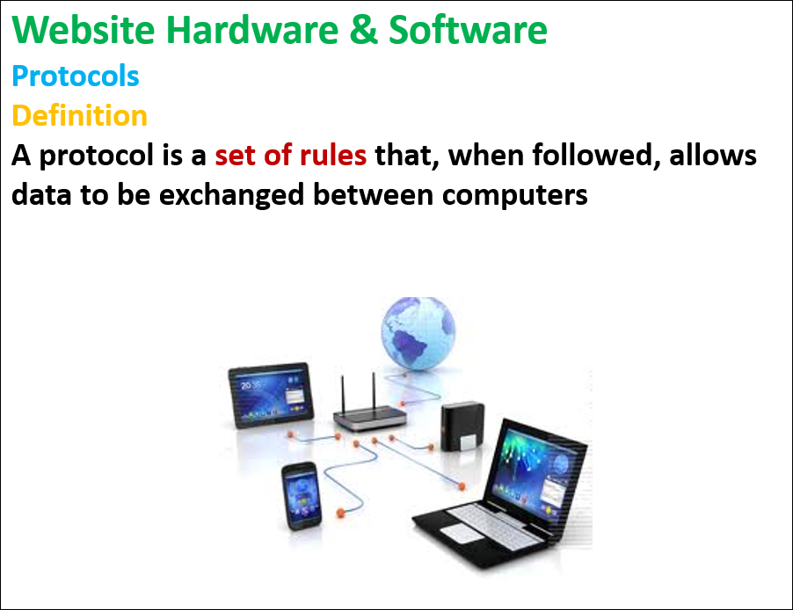
Design principles
Proportion
Information that is more important should be made larger so it stands out.
In a presentation headings and sub-headings should be in larger font (and in bold) then the rest of the information.
This makes it easy for the user to understand what the information on each slide is about.

Slide 4
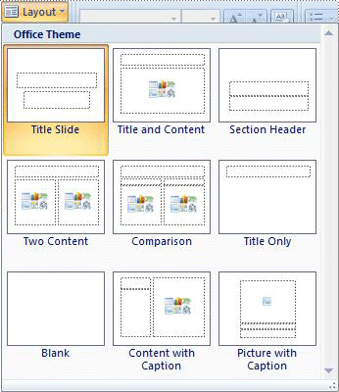
Design principles
Layout
The layout is the structure used on each slide to display the data.
Presentation software comes with many layouts to chose from.
You can also create your own.
There is not ‘one’ correct layout.
Rather you should use a layout that is suited to the information that needs to be displayed.

Slide 5
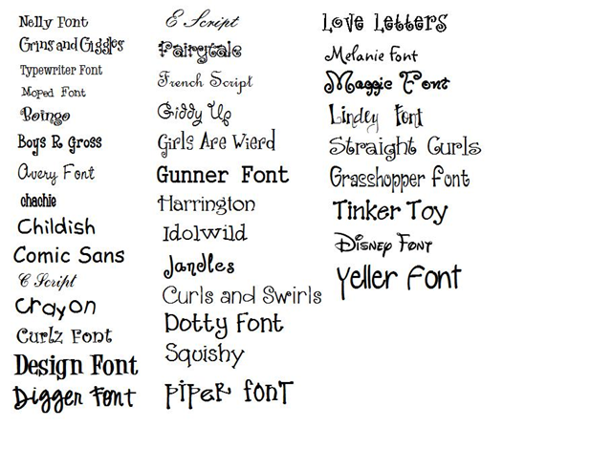
Design principles
Clarity
Can all of the data and information be easily read?
Clarity often relates to the font types (and font sizes) used in the presentation.
Which fonts are easy to read?
Which fonts are difficult to read?

Slide 6
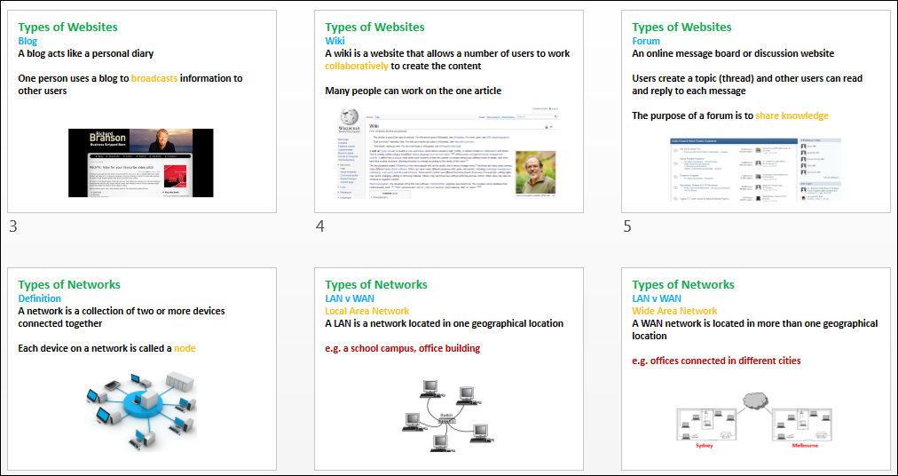
Design principles
Consistency
Use similar elements on every slide.
Not every slide has to be exactly the same
But try and use:
similar layouts
similar fonts and sizes
similar colour schemes
This reduces that chance that the user is confused about the information.
The presentation shown uses consistency. How?

Slide 7
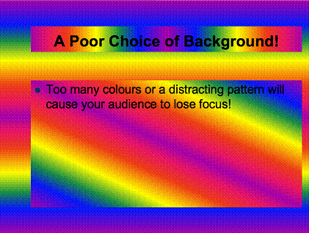
Design principles
Colour
Keep the number of colours used to a maximum of 3 or 4.
Avoid too many colours and too many bright colours.
This can make the presentation hard to read and unattractive.
What is wrong with the slide shown?

Slide 8

Design principles
Contrast
Does the text stand out from the background?
Can a user read the text?
Use a dark font on a light background or a light font on a dark background.
How many times is contrast written in the image shown?
3, 4 or 5 times?

Slide 9

Design principles
White space
White space can also mean blank space.
Leave blank space on each slide, do not fill up all of the slide.
Do not included too much information on the one slide.
Use dot points for text
Keep each dot point short
Only use 3 or 4 points per slide
Too much information overloads the user and they can not understand the information.

Slide 10

Activity: Travel destinations
Travel destinations
Create a presentation, following the design principles mentioned, that give the user some brief information about the cities listed below:
Bali London
Paris Rome
New York Crete
Note:
You can add more locations if you finish early.

Slide 11
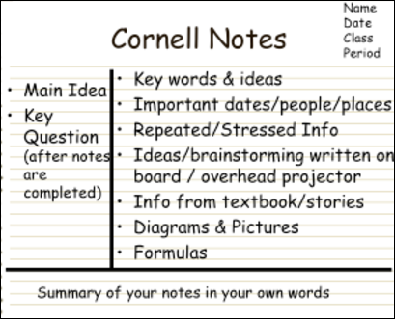
ICT Workbook Notes
Make notes on the following:
Design principles
Proportion
Layout
Clarity
Consistency
Colour
Contrast
White space

Slide 12

Post-class activity: design principles quiz
Complete the quiz on design principles on eLearn.

